Slide 1


CHAT APPLICATION
Task - 1

Slide 2


Introduction
The chat application is largely responsible for the evolution of communication in today's globally connected world. A chat application is a multipurpose and essential tool that lets people use text, multimedia, voice, and video to communicate in real time. It has transformed the way we communicate with friends, family, coworkers, and acquaintances, shrinking and opening up the world.
LMS Username | Name | Batch
au721220104301 | Ananth K | CD1_6
au721220104019 | Kodeshwaran S | CD1_6
au721220104060 | Vijaya Suriyan TS | CD1_6
au721220104305 | Sam Joel L | CD1_6

Slide 3


Task - 1
Creation of SRS & Github
Create SRS : “Your Project”
Creation & Set-up of Github account
Creation & Hands-on to various commands of Git Bash
Evaluation Metric:
100% Completion of the above tasks
Learning Outcome
Get to know about different lifecycle models.
Understanding importance and how to create an SRS
Knowing various commands of Github
Understanding agile and scrum management techniques for efficient product development

Slide 4
Step-Wise Description
Registration and login
Edit profile settings
3.Search user
4.Message to user
5.Create group chat
Summary of your task
Generating Responses: Depending on the input and context, I provide human-like responses that include pertinent information, thoughtful dialogue, and question-and-answer exchanges.
Maintaining Context: Throughout the chat, I was able to provide comments that were both logical and pertinent to the context since I could recall it.

Slide 5





Assessment Parameter
Gather requirements for the
project
add Readme.md file with description of the project
Prepare database design
schemas
Check-List
Commit all changes with "first commit"
Get your initial project
Structure ready
create a repository on github related to project
Initiate a git repository
Push your changes to github

Slide 6
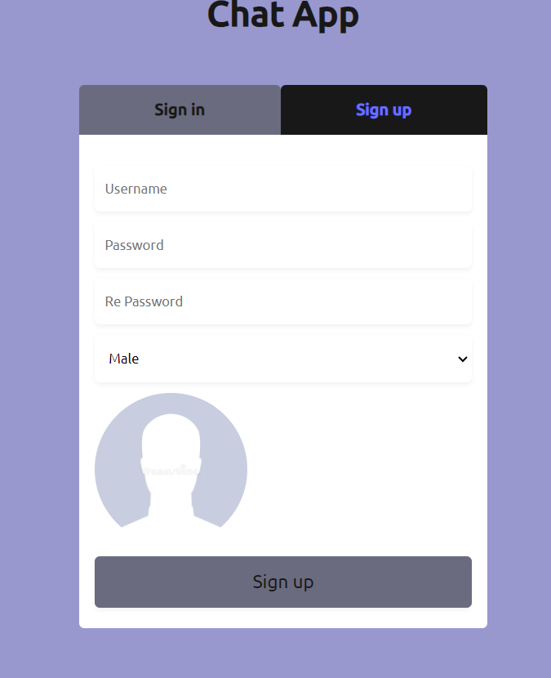
SIGN UP PAGE

Slide 7
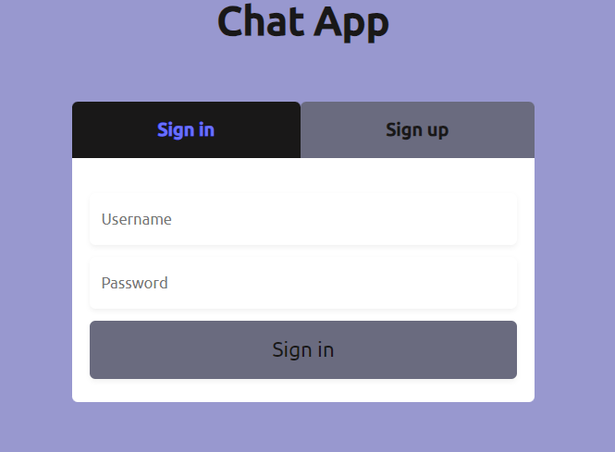
LOGIN PAGE

Slide 8
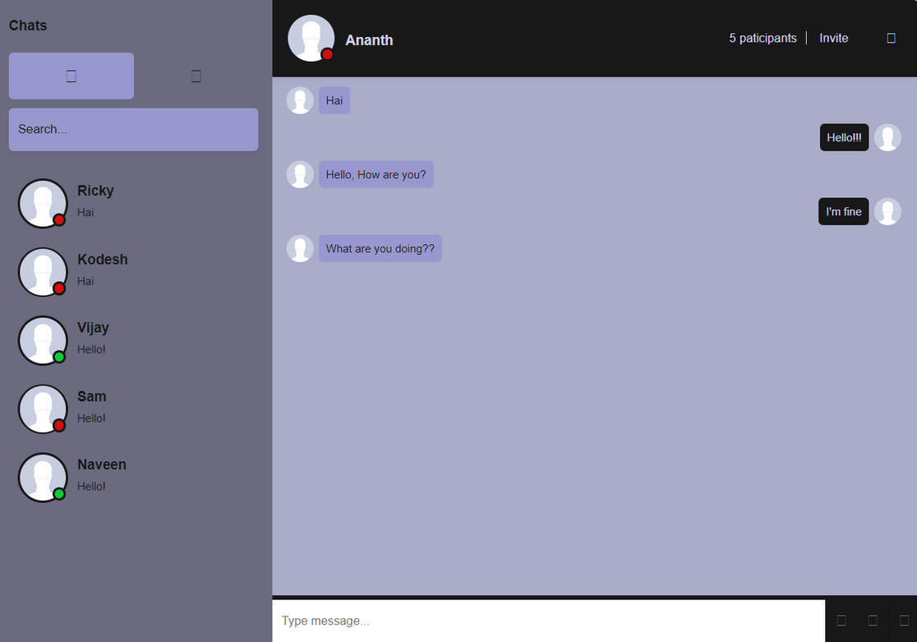
CHATTING PAGE

Slide 9


Submission Github
https://github.com/ananth-1206/CD_06_Task-2_FrontEND
https://github.com/KODESHWARAN2002/CD1_06-Task2_FrontEnd
https://github.com/samjoel2002/CD1_06_Task2_FrontEnd.git
https://github.com/Vijayasuriyan1003/CD1_06_Task2_FrontEnd.git

Slide 10


